Slide 1
Beam Damage in X-ray Absorption Spectroscopy
Q2XAFS (Quality and Quantity of Data in XAFS)
Prepared by: Arun Asundi, Macon Abernathy, Ritimukta Sarangi
Contributions from: Kiyotaka Asakura, Jan Kern, Serena DeBeer, Sofia Diaz-Moreno,
Giuliana Aquilanti, Yasuhiro Niwa, Paola D’Angelo, Alexey Maximenko, Adam Hoffman, Eli Stavitski, Hitoshi Abe, Graham George, Anna Regoutz, Shelly Kelly, Bernt Johannessen, Ilaria Carlomagno

Slide 2
Our Approach
Five Areas Relevant to Beam Damage
Definition and Mechanisms of Beam Damage
Identifying and Mitigating Beam Damage
Data Processing and Interpretation
Standards for Reporting
Future Requirements and Outlook
Contributions from Expert Collaborators
Deliverables
Slides sharing thoughts and experiences related to these five areas
Two 2-hour zoom discussions
Review and feedback on final report and presentation
Presentations of working group results
Report to be published on summary and recommendations related to beam damage
5 recommendations for users
5 recommendations for BL scientists

Slide 3
Beam Damage: Definitions and Mechanisms

Slide 4
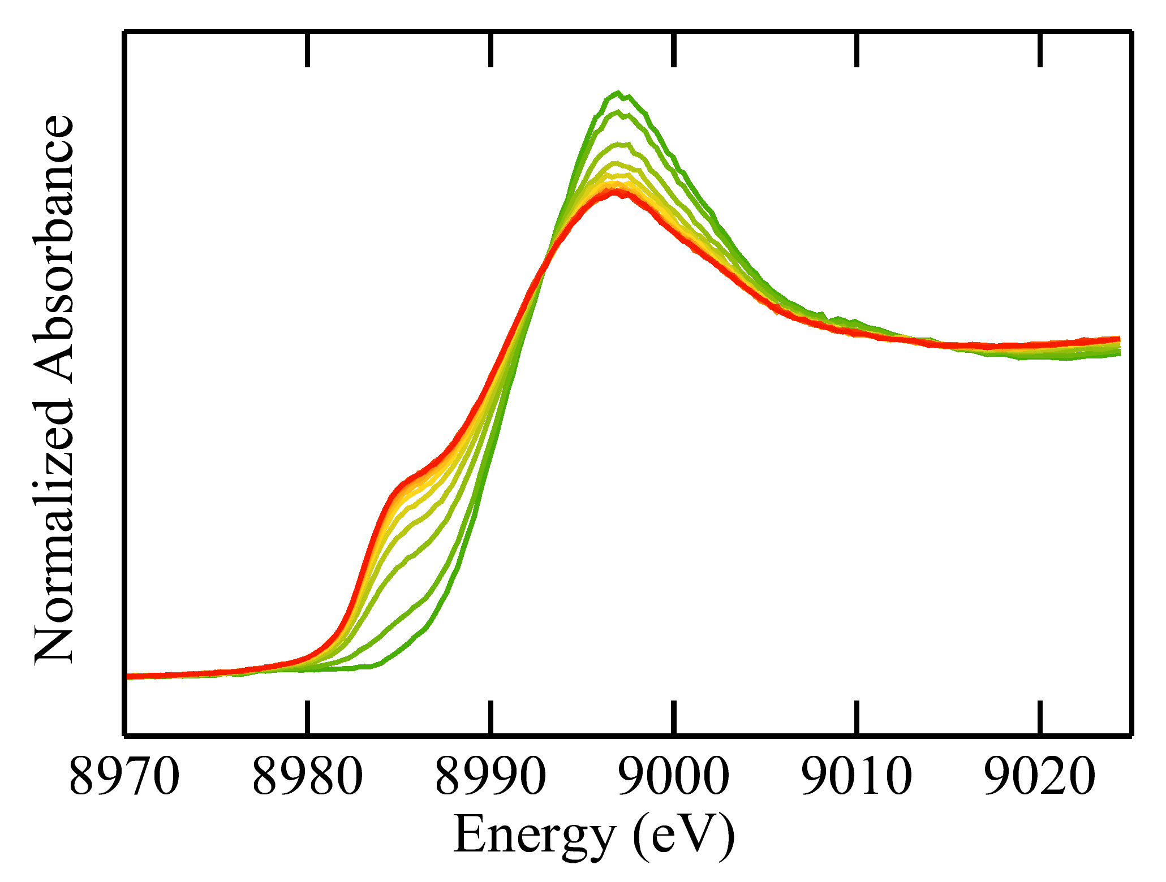
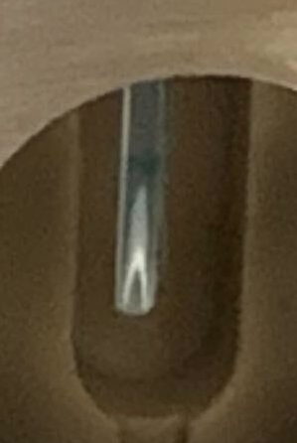
What is Beam (Radiation) Damage?
Beam damage: Undesirable X-ray dose dependent change in sample or sample environment
  Chemical changes: Photoreduction, photo-oxidation, ligand photolysis
  Physical changes: Particle agglomeration, crystallinity changes, sample ablation/dissolution
  Photo-induced processes: Photo-catalysis, metal-ligand charge transfer
  Sample environment damage: Deposition on sample holder, X-ray window damage, degradation of electrolyte
Even very robust samples are susceptible to damage at high X-ray dose
Photoreduction of Cu(II)
Deposition on capillary
Exposure time
Cu(II)
Cu(I)

Slide 5
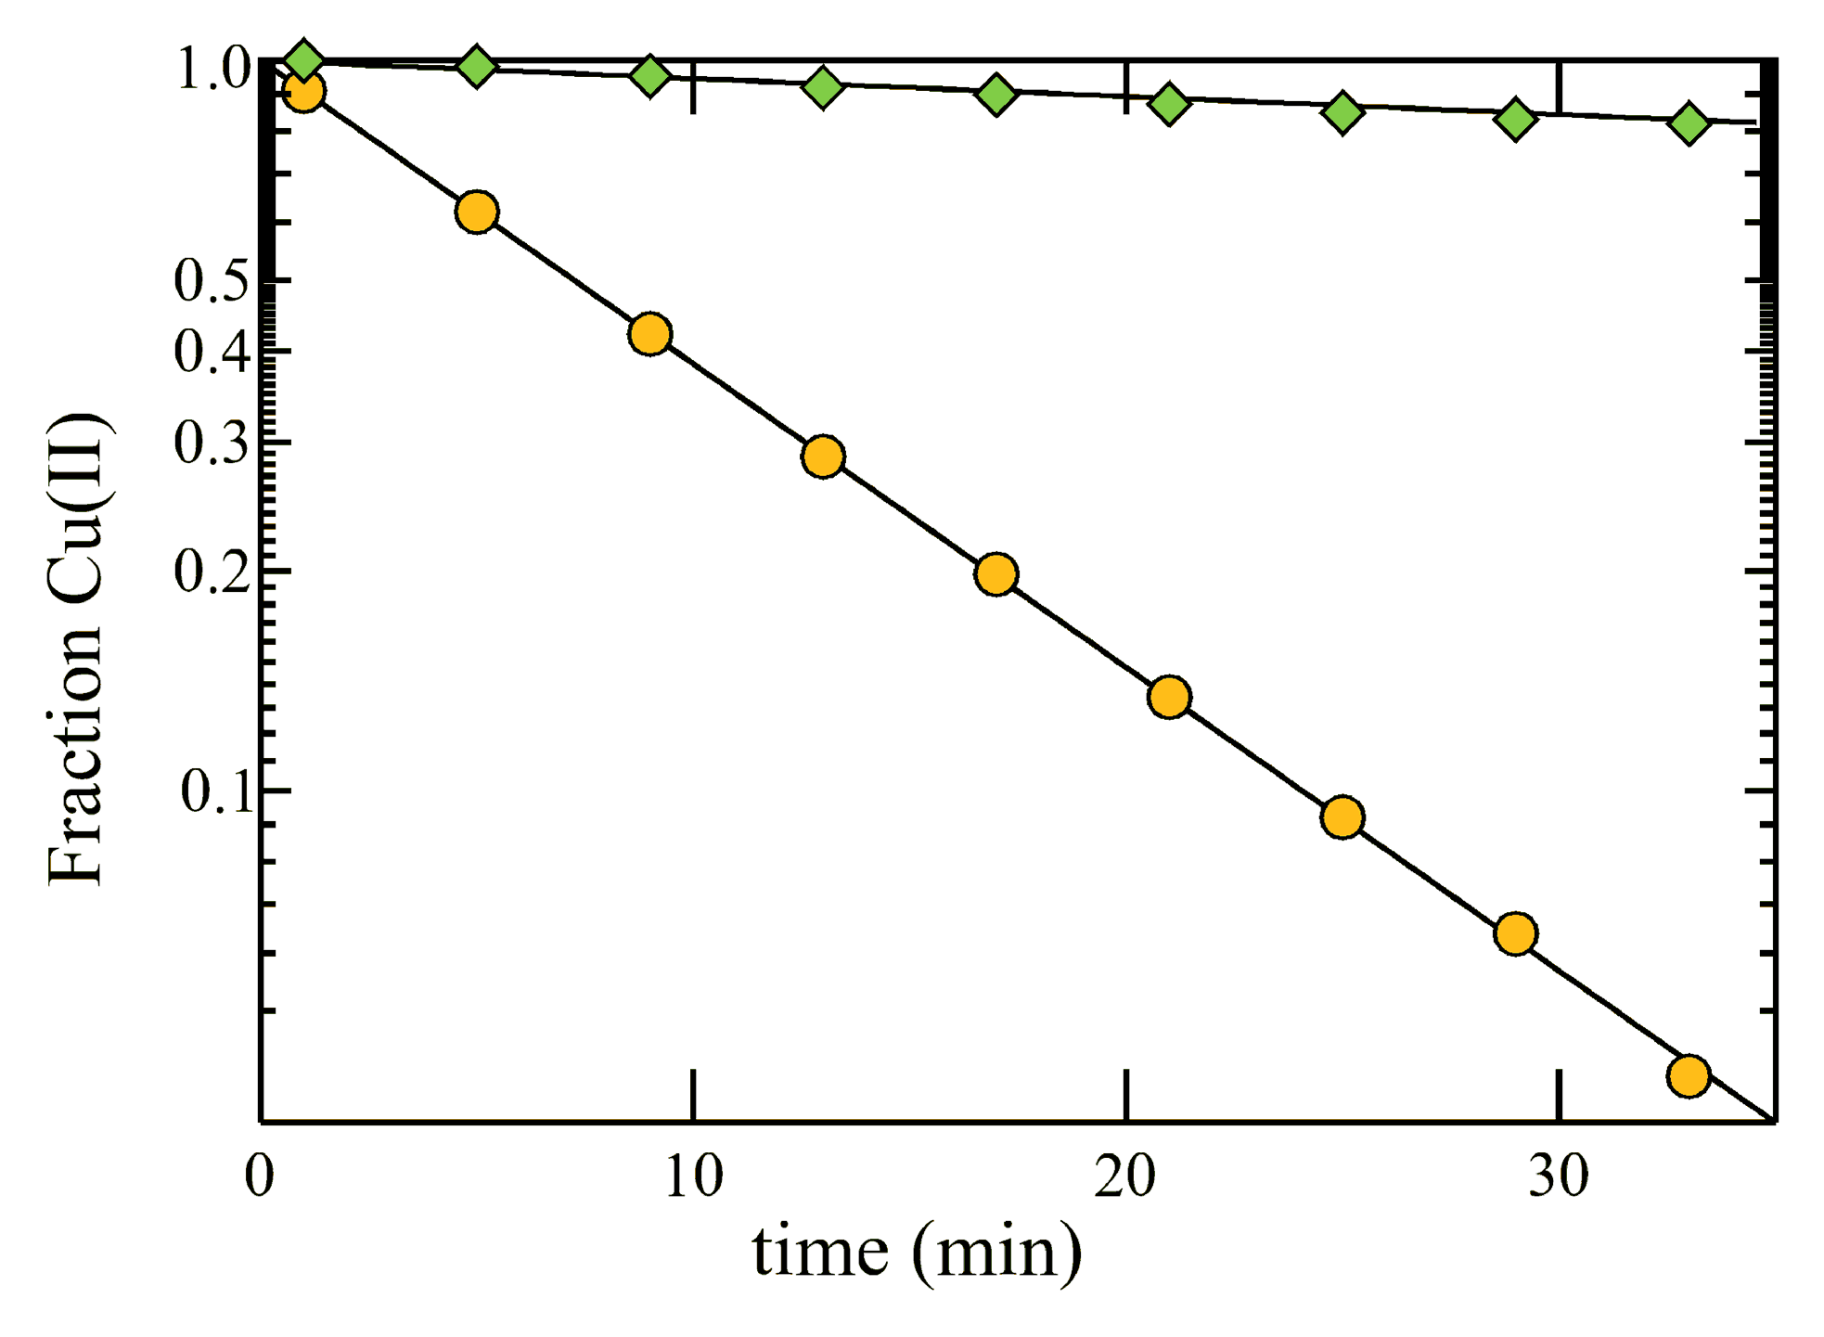
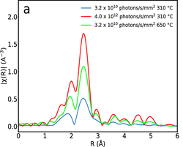
Factors Affecting Dose-Damage Relationship
Multiple damage processes may simultaneously occur, making modeling complicated
Generation of oxidizing and reducing agents induce chemical changes, e.g., radiation chemistry of water:
H₂O + (ionizing radiation) → [H₂O]•⁺ + e–_{aq}
[H₂O]•⁺ + H₂O → [H₃O]⁺ + HO•
Hydrated electrons (e–_{aq}) are strong reducing agents
Hydroxyl radicals (HO•) are strong oxidizing agents
Dose-damage relationship affected by:
  Sample environment (T, preparation, impurities)
  Beamline configuration (flux density, spot size and shape)
  X-ray energy
  Surface/bulk sensitivity of detection method
-glycerol
+glycerol
Reactions carried out at 10 K
K. Nienaber et al.
DOI: 10.1021/acs.jpclett.7b03111
Agglomeration of Rh particles
M. Albrahim et al.
DOI: 10.1021/acs.jpcc.1c01823

Slide 6
Recommendations for Users

Slide 7
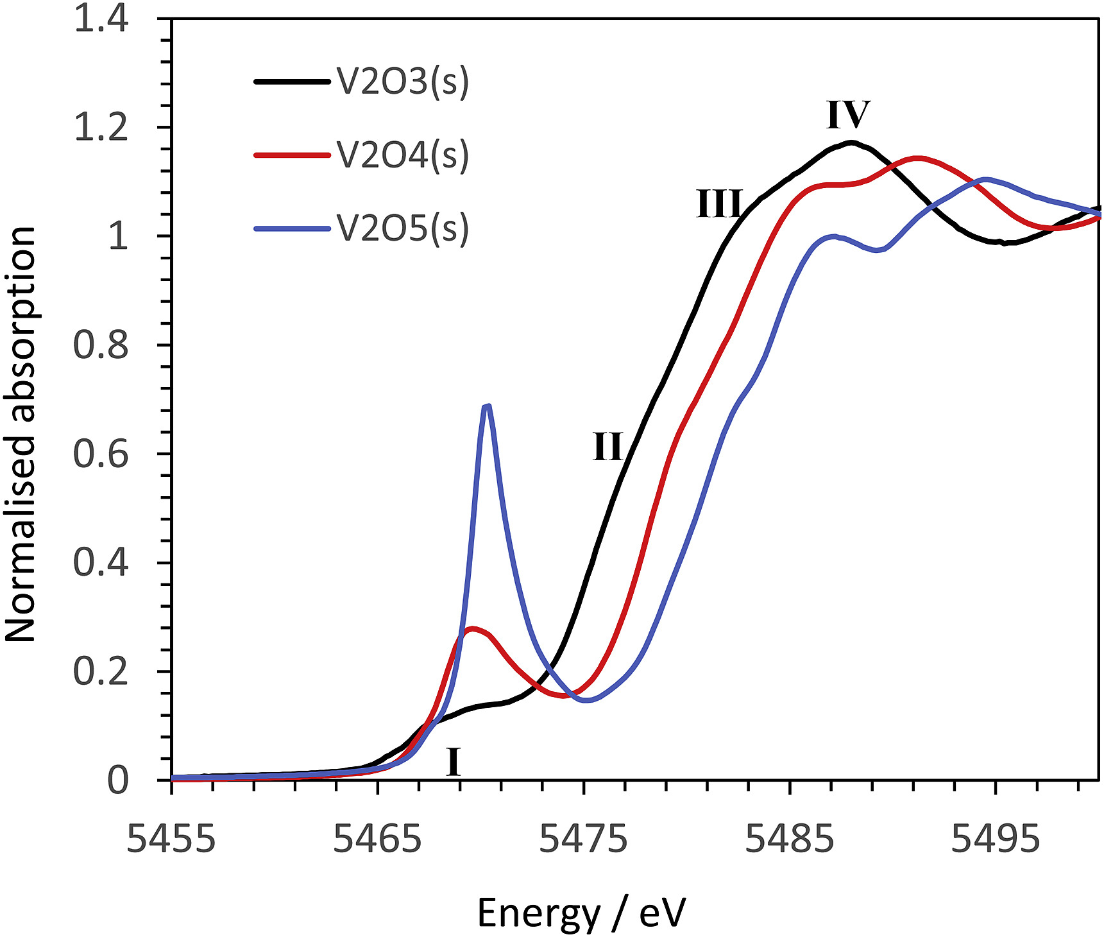
Know Your Sample
Knowledge of sample from lab-based techniques establishes baseline, from which beam damage can be evaluated
  Describe expected spectral features based on proposed structure, oxidation state and coordination chemistry
For in-situ experiments, what are the structure/chemical properties of the starting material and how are they expected to change during the experiment?
  References and ex-situ samples can help guide expectations
Users should bring knowledge from literature or previous measurements
XANES of Vanadium Oxides
H₂ Reduction of Rh₂O₃ Nanoparticles
J. P Gustafsson
DOI: 10.1016/j.apgeochem.2018.12.027
Lab TPR shows higher reduction temperature of Rh₂O₃ than Rh K-edge TPR-XANES

Slide 8
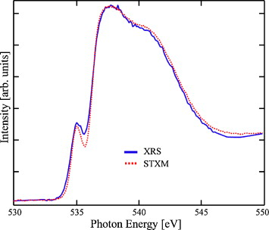
Identifying and Minimizing Beam Damage
Before measurement
  Allocate time in proposal request for beam damage studies
  Prepare sample for optimal data quality with minimal beam exposure
  Consider alternate measurements to gain similar information (e.g., hard X-ray Raman vs soft X-ray XAS)
During measurement
  Monitor edge step
  Measure time series on features sensitive to sample changes (pre-edge, edge, white line) for duration of a full scan
  Compare multiple spectra collected on single sample spot
  Move to new spots periodically and compare spectra
Water
O K-edge
A. Nilsson et al.
DOI: 10.1016/j.elspec.2010.02.005
Constant E time scan, Cu MOF

Slide 9
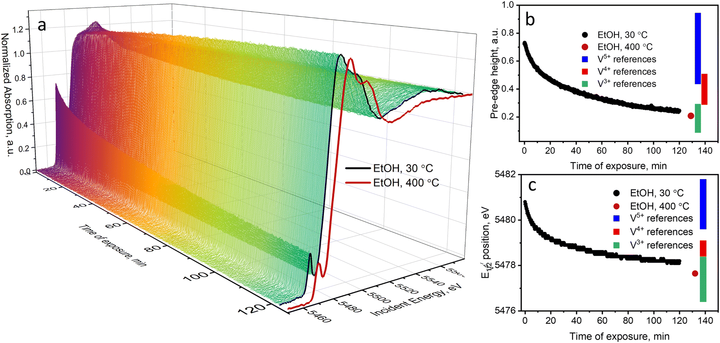
Data Processing and Interpretation
One should strive to obtain damage-free data by adjusting experimental conditions.
If this is not possible, then effects of beam damage must be explicitly addressed.
Generate a dose-dependent series of spectra to examine trends with X-ray exposure
  Use spectral features that grow/shrink in response to photodamage to estimate percentage change with exposure time
  Collect spectra on a fully damaged sample and use it to deconvolute the measured data and estimate a “zero-dose” spectrum
Calculated spectra can support these analyses if computational methods are established for similar systems
A. Zabilska et al.
DOI: 10.1039/D2CP02721F

Slide 10
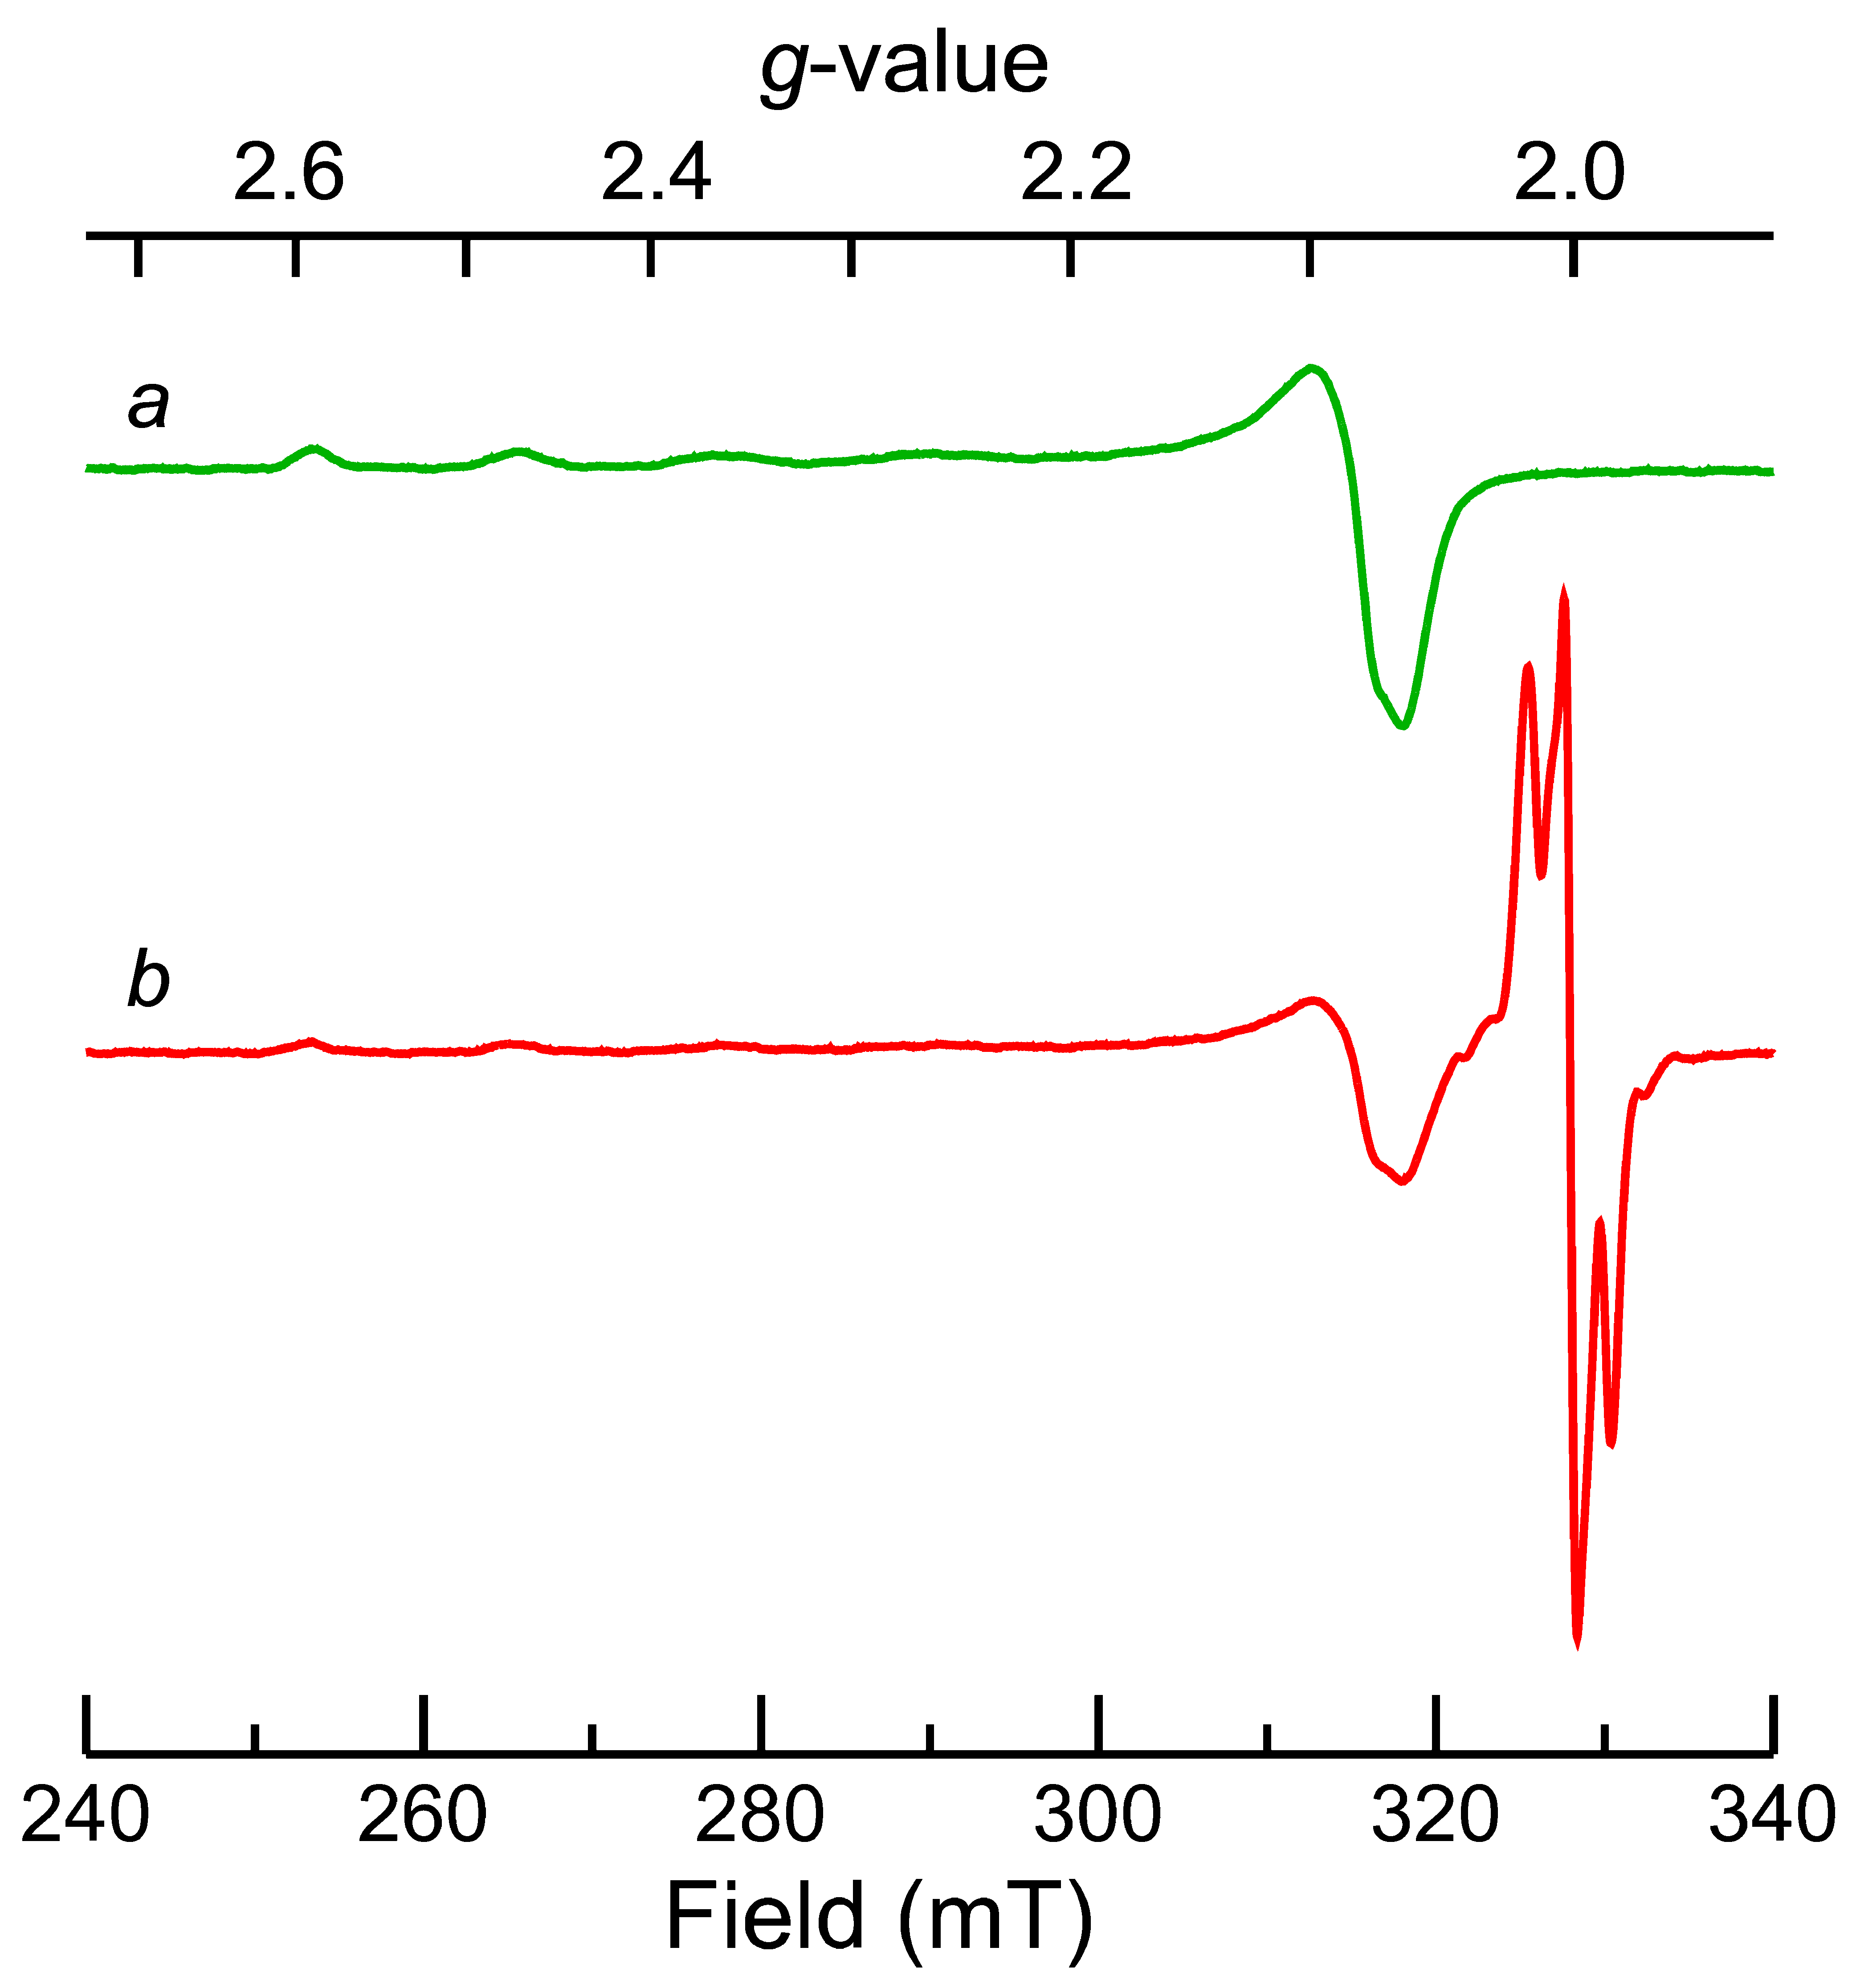
Correlating Beam Damage with Other Techniques
Measurements of model species can be used to benchmark and predict effects of dose, temperature, or scavengers on samples of interest
Complementary measurements can be used to quantify extent of beam damage
  UV-vis or IR spectroscopy, ideally in
  parallel with X-ray measurements to
  quantify extent of sample change
  EPR can provide insights, although free
  radical g = 2.0 can dominate the signal and
  sample may need to be annealed first
  Mössbauer spectroscopy before and after
  measurements for Fe
  Change in long-range order assessed using XRD
Unexposed solution:
Cu(II) S=1/2 EPR
Exposed solution:
reduced Cu(II) + free radical
Free radical signals

Slide 11
Standards for Reporting Data on Beam Damaged Samples
Beam damage is often not reported at all – even if final datasets were obtained under damage-free conditions, investigations into beam damage should be reported
Suggested inclusion
  X-ray flux density (ideally at the sample position)
  Exposure time per sample spot
  Method used to assess beam damage
  Mitigation methods (if used)
  At least one SI figure showing evidence of damage-free data collection on a representative sample
Additional useful details:
  Unsuccessful/damaged measurements
  Dose-dependent series of spectra
  Gas composition and length of ion chamber
  Utilize “laboratory notes” section to describe beam damage assessment and mitigation methods

Slide 12
Recommendations for Beamline Scientists

Slide 13
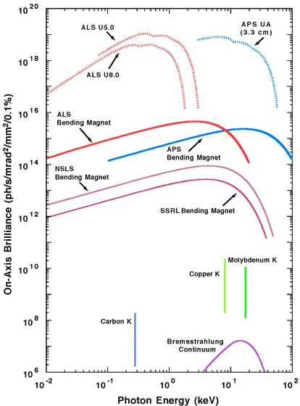
Understand Beam Characteristics
Understand flux density, spot size and shape to accurately quantify
X-ray dose on sample
Flux density measured with photodiode or ion chambers – choice is beamline-dependent
  Ion chamber: for high flux beamlines, low absorption leads to sensitivity to small variations
  Ion chamber: Compton scattering contributions can result in
  non-linear response to flux
  Photodiode: Can be placed at sample position but not measured simultaneously
Characterize variations in flux with energy
BL scientists should take the lead characterizing and documenting flux density
  Measure during setup and communicate flux, spot size to user
  Write meta data (e.g., ion chamber readings) to data file
J. Helliwell
DOI: 10.1038/1307

Slide 14
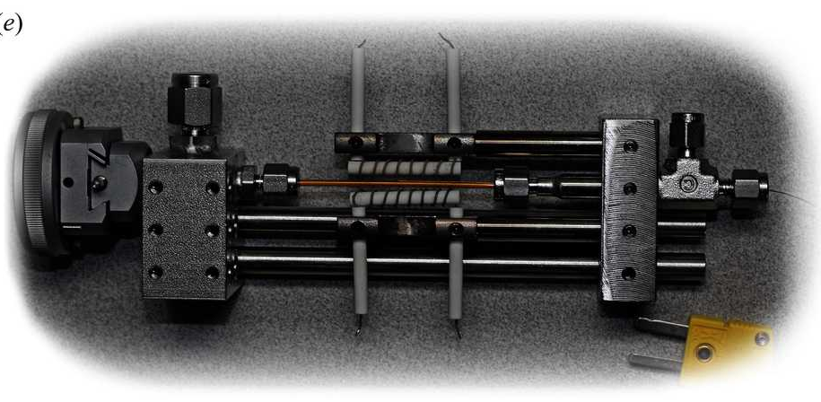
Developing and Maintaining Sample Environments
Hardware supplied to users should be tested and characterized – reproduce published data to confirm integrity of experimental apparatus
Consider trace impurities (especially moisture) when developing sample environments
Accommodate beam-off measurements using same hardware if relevant to compare sample behavior with and without beam
Validation procedures should be performed regularly
P. J. Chupas et al.
DOI: 10.1107/S0021889808020165
S. Bak et al.
DOI: 10.1038/s41427-018-0056-z

Slide 15
Beamline Optimization and Data Collection
Provide users with options to adjust flux – defocus, detune, slits, filters, sample angle, rastering
Educate users on when and how to use these options
Request a representative sample from user and assess beam damage during setup time; hand off beamline to user with clear recommendations on how to collect damage-free data
Consider the “dark” period
  Use shutters to limit sample exposure to beam when data is not being collected
  Long-range damage due to diffusion of radicals continues when beam is off – fast hardware/software needed to reduce deadtimes
Encourage a culture of assessing beam damage and documenting measurement conditions among users

Slide 16
Outlook

Slide 17
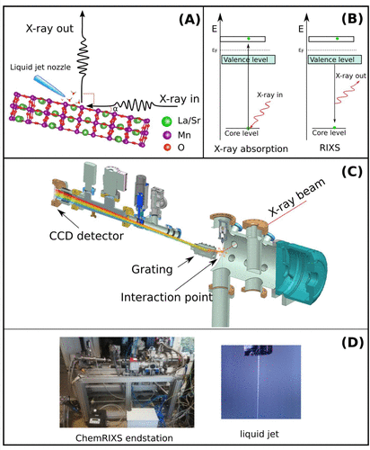
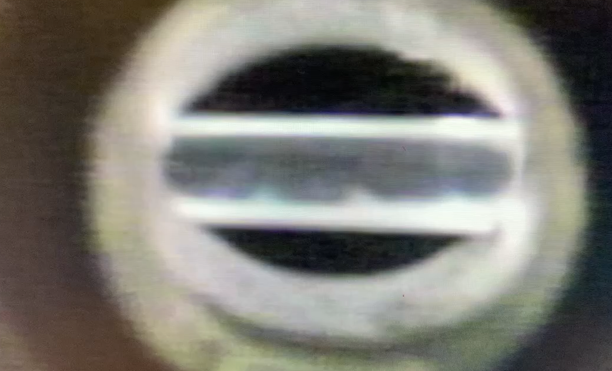
Upcoming Challenges
Higher flux and more focused beams will increase dose. New methods are required:
  Faster hardware/software for data collection
  Significant beam attenuation
  Serial data collection strategies
  Serial sample delivery methods (droplets, microfluidics, liquid jet)
  Methods for simultaneous methods to monitor damage
Increased interest in operando measurements (especially for biological samples) in solution leads to conditions that are more susceptible to beam damage than typical 10 K measurements
Explicit consideration must be given to measurement reproducibility – will require a portion of beamtime
Collaboration with other X-ray communities can help preempt challenges
T. Reuss et al.
DOI: 10.1021/acs.accounts.2c00525
Protein aggregation in solution (video)

Slide 18
Quick Look at Our Recommendations
Recommendations for Users
Recommendations for Beamline Scientists
Know your sample: what spectral features are expected based on oxidation state, structure, changes during in-situ treatment, etc.?
Prepare your sample: discuss sample preparation strategies with beamline scientist to minimize beam exposure and damage pathways.
Assess beam damage: measure fixed energy time series at 3 points on pre-edge/edge/white-line for the duration of a full scan.
Mitigate beam damage: Discuss mitigation methods (shutters, filters, rastering, detuning, defocusing) with beamline scientist.
Report your results: Provide flux density, exposure time, damage mitigation methods, and evidence of damage-free data collection – can others reproduce your results?
Characterize beam: Routinely measure flux density, spot size and shape at the sample position to quantify X-ray dose.
Robust sample environments: Characterize trace impurities in sample environments and ensure results are reproducible. Accommodate beam-off experiments with same hardware if relevant.
Mitigation strategies: Incorporate damage mitigation methods into beamline hardware (shutters, filters, sample rastering, detuning, defocusing).
Educate users: Encourage a culture of assessing beam damage, employing mitigation strategies, and documenting beam characteristics.
Future developments: Consider sample delivery, proper attenuation, and simultaneous complementary characterization when developing next-generation beamlines.

Slide 19
Quick Look at Our Recommendations
Recommendations for Users: MAP
Recommendations for BL Scientists: FEED
Mitigate – Know your sample and expected spectral features before beginning experiments. Discuss sample preparation and mitigation strategies with beamline scientists.
Assess – Assess beam damage before beginning data collection. Employ mitigation techniques if dose-dependent changes are observed.
Publish – Discuss investigation of beam damage when publishing data and include evidence of damage-free data collection.
Flux – Understand beam characteristics to quantify X-ray dose on sample. Routinely characterize beam and ensure metrics are written to meta data.
Enable – Incorporate beam mitigation strategies into beamline hardware. Characterize sample environments provided to users and accommodate beam-off experiments.
Educate – Educate users on best practices surrounding beam damage. Encourage a culture of documenting beam characteristics.
Develop – Design appropriate damage mitigation methods for future brighter beamlines, including sample delivery, proper attenuation, and simultaneous complementary characterization.

Slide 20
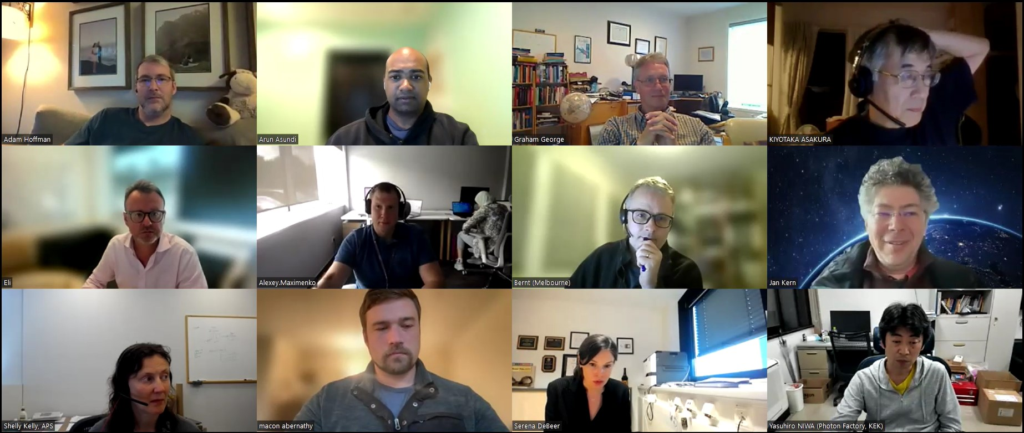
Acknowledgements
Kiyotaka Asakura
Jan Kern
Serena DeBeer
Sofia Diaz-Moreno
Giuliana Aquilanti
Yasuhiro Niwa
Paola D’Angelo
Alexey Maximenko
Adam Hoffman
Eli Stavitski
Hitoshi Abe
Graham George
Anna Regoutz
Shelly Kelly
Bernt Johannessen
Ilaria Carlomagno

